Slide 1


Experience Layer
Amdocs DigitalONE

Slide 2
Agenda
Experience Layer
Client side Overview
Technologies
SDK Overview
Concept
Functional flow example
Experience layer server side components
Widgets Overview
Q & A

Slide 3

Amdocs DigitalONE Platform
Enabling the journey to digital service provider
SELF-SERVICE
RETAIL
CRM
ENTERPRISE PORTAL
CHANNEL EXTENSIONS
ANY APPLICATION
Mobile & Web
In-store
Call center
Web
Social / Chat / SmartBot
DIGITAL EXPERIENCE LAYER
PLATFORM
Expose commerce and care services, through REST APIs, comply with TMF
DIGITAL MICROSERVICES LAYER
Commerce & Care
Intelligence Platform aia
Integration Layer
Amdocs CES: charging/order handling/billing | Amdocs Ensemble/Kenan/any BSS system
Back-end engines

Slide 4




Digital Experience Layer From Functional Capabilities to User Experience
DIGITAL EXPERIENCE LAYER
SELF-SERVICE
RETAIL
CRM
ENTERPRISE PORTAL
CHANNEL EXTENSIONS
ANY APPLICATION
Mobile & Web
In-store
Call center
Web
Social / Chat / SmartBot
Amdocs Mobile Enablement
WCMS
(AEM)
Commerce widgets
Billing care widgets
Support widgets
Customer care widgets
Multi modal plug-ins
legend
Commerce
Care
Experience APIs Approach
Digital Commerce & Care (DC&C) Services – Generic and Reusable (TMF’s Open API)
Experience Services – Client Specific
Client SDK & Web Components/Widgets – consume functional capabilities
Experience Management/Admin – Manage content in context of audience segmentation, behavior and brand activity (campaigns)

Slide 5








Digital Platform – client side architecture (UXF 1.5)
CHANNEL APPLICATION
DIGITAL SERVICES LAYER
Self service web portal
Self Service mobile application
Retail application
Call center application
Any application
Adobe Experience Manager
Import
Widget repository
AEM component
C
Amdocs widget
W
Widget (Default view)
AEM pages
AEM widget pallet
Actions
Page
W
W
W
W
C
C
C
C
C
C
C
W
Store
Digital client
W
W
W
W
W
W
C
C
C
C
UI metadata
Transient state
Application sate
Smart
SDK
AEM publisher (runtime server)
Rest client kit / Client services
HTTP(S)
Digital catalog
Catalog discovery
Commerce price
Order capture
Customer profile
Customer care
Customer product
User management

Slide 6
Experience Layer Overview - Technologies

Slide 7
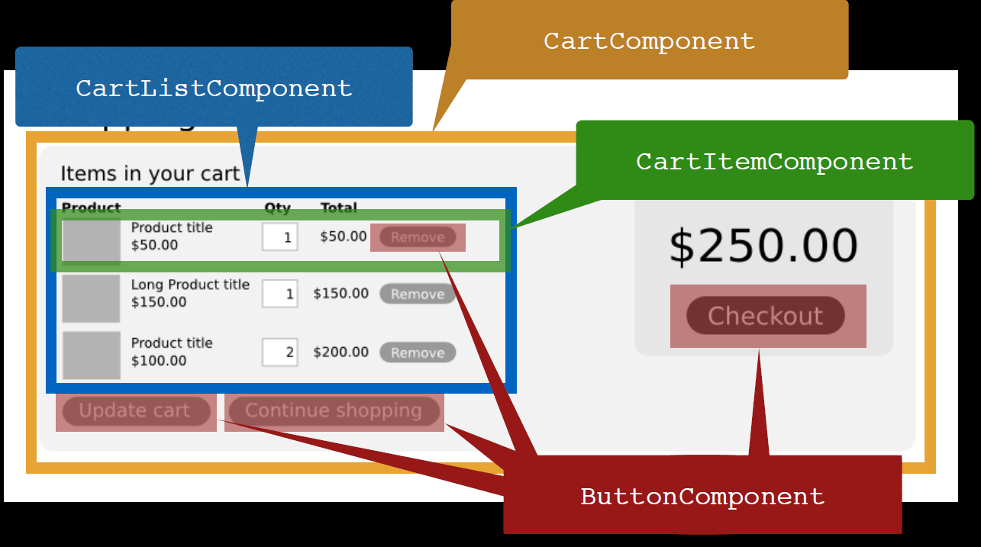
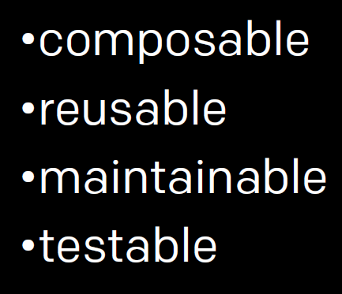
Technological Skeleton of UXF, React
React – Javascript framework that manipulates the view layer
React Principles:
Everything is a self contained component
Build components not templates

Slide 8
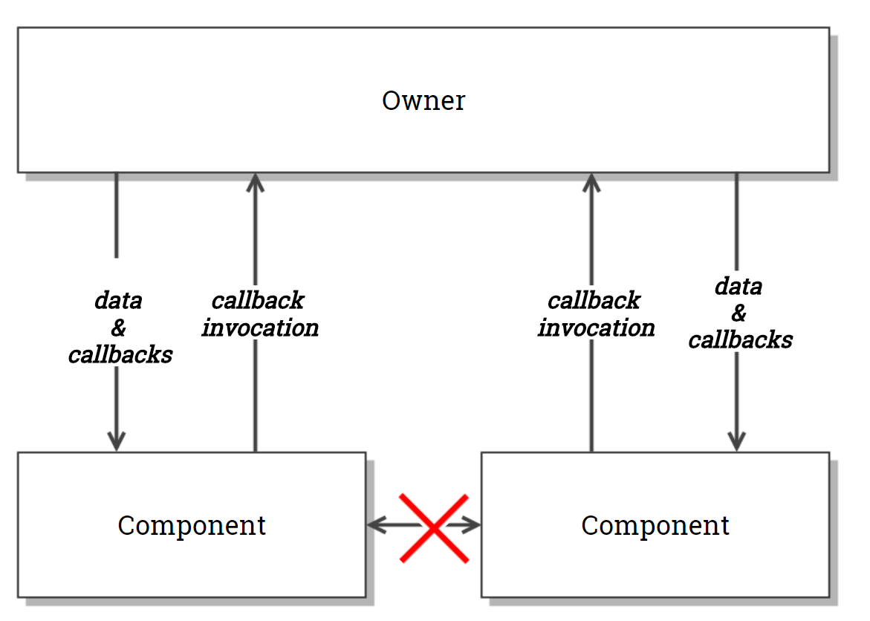
Facebook’s React
React – Javascript framework that manipulates the view layer
React Principals:
One way binding
Events flow up, data flows down

Slide 9
Facebook’s React
React – Javascript framework that manipulates the view layer
React Principals:
Virtual DOM –
Re-render –
don’t mutate
Virtual dom is a pure Javascript, in-memory
representation of the DOM
render() fires whenever something changes
React modifies the real DOM to match

Slide 10
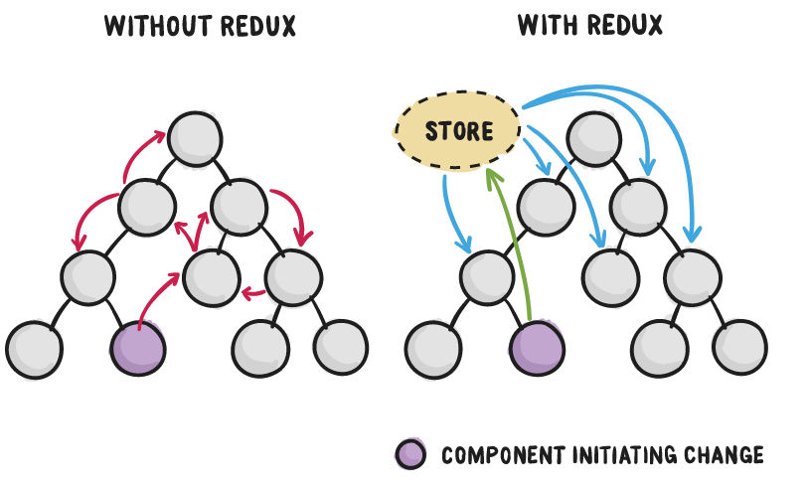
Technological Skeleton of UXF, Redux
Redux – Modular State Management
Without Redux (or message bus/hub)
Data flow between components
Component may push data
Component may subscribe to data
With Redux
Changes apply to the state
Component’s state subscribes to actions
State updates connected components directly

Slide 11
Additional technologies
ES6 (ES 2015) – Client Kit Services
Industry JavaScript language standard, W3C
Trivially portable to previous JavaScript standard: ECMAScript 5
Widely supported (up to 90 - 95% of total feature set)
Intended to improve development practices and standards
Build frameworks
Webpack – App/Component packager
Automatic code-splitting
Automatic lazy loading
Agnostic to module syntax/standard (ES6/RequireJS/CommonJS)
npm – module management (Nexus)
Central repository

Slide 12
SDK modules

Slide 13
SDK modules
Module is a standalone unit that is responsible for a specific functionality
Module encapsulate data and supply services (APIs) to manage it
Module’s store data is visible only to this module – there is no direct access for other modules
Module may handle multiple instances of data
Examples of modules are:
Customer , CustomerProfile
Bill, Cart, Order
Etc.
Full list can be found in https://confluence/pages/viewpage.action?pageId=38976457

Slide 14
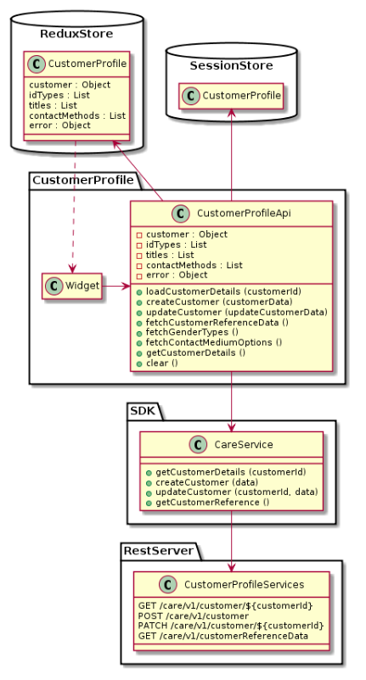
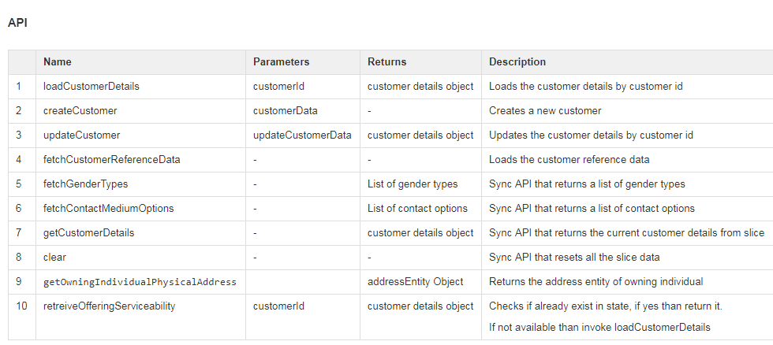
SDK modules – CustomerProfile module example
Shows the data that is persisted in session storage (available after full page refresh)
The module fields (exposed only to the customizer of CustomerProfile) and APIs (exposed to everyone)

Slide 15
COP flow design example
https://confluence/display/DIGIUI/%5BFlow-001%5D+COP+-+Mobile+Subscription+-+Anonymous

Slide 16
Digital Experience – Client Architecture
1
HTML via JSX notations; no business logic making it lighter, UI focused, easily replaceable.
View
React View
1
Abstracts common logic for view (i18n & configuration merge & relate to store) making it more standardized
8
2
Container
HUB
2
Dispatches actions to manipulate store or fetch/update backend services. Part of Client SDK to keep business logic separate.
Connect
3
Client SDK
4
Introduced to Intercept dispatch & manipulate Store taking more responsibility of managing the state as per standard design patterns keeping it less proprietary.
Subscribe to changes
3
Actions
Dispatch
Application state stored at single place as immutable Simple JS object which becomes single source of truth making it easy to maintain. >>
API Call
5
5
Store (Redux)
Dispatch
6
Expose JS APIs to REST service AJAX calls (URIs, Payloads) independent module making it easier to customize with lesser lines of code.
New State
6
Services
Reducer
Introduced experience APIs acting as a contract b/w UI and backend systems making it backend technology agnostic.
AJAX
4
7
Experience API
8
Introduced to provide publisher/subscriber functionality to allow external applications to connect to our the state mgmt making it a standard way of communication
REST Services
7

Slide 17
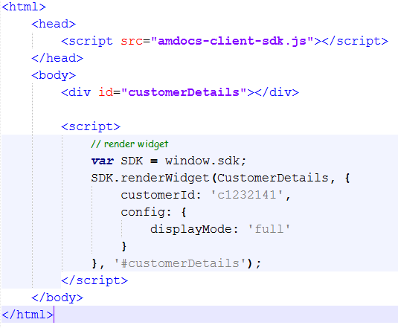
Widget consumption using Javascript
Import to Amdocs SDK library
Command to render widgets
Name of the widget to render
Property information to pass to the widget
Configuration data to pass to the widget

Slide 18
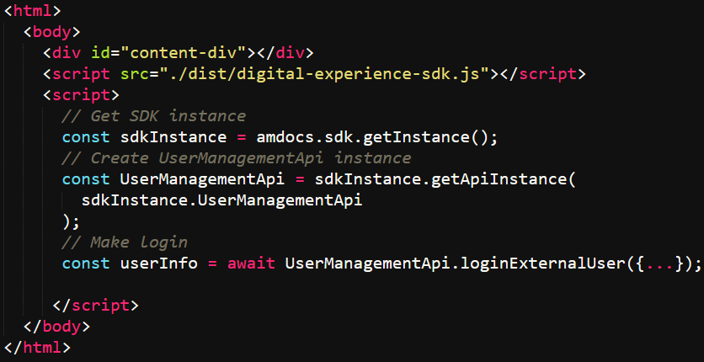
SDK consumption
Import Amdocs SDK library
Get SDK instance
Get UserManagementAPI instance
Invoke an action to make user login

Slide 19
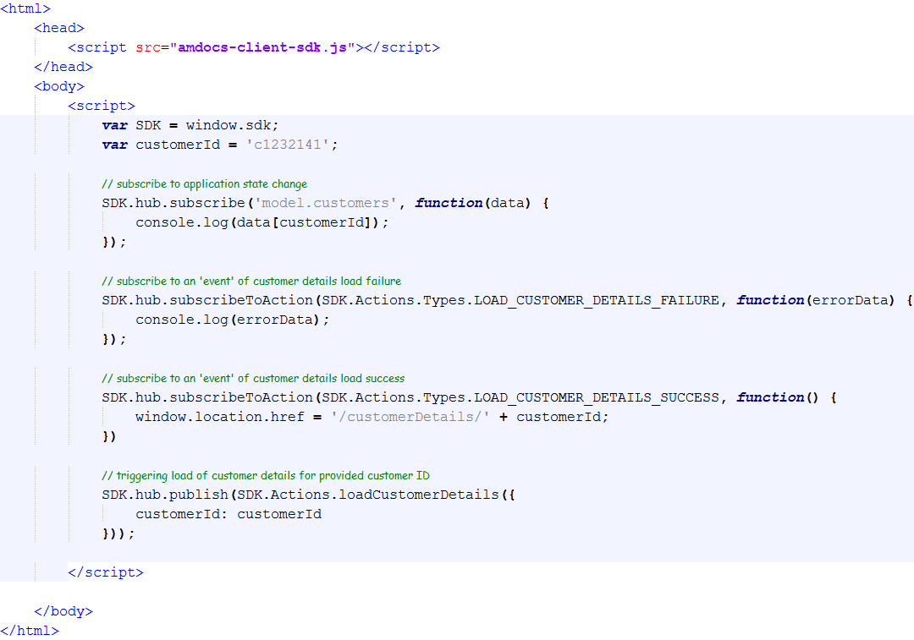
SDK consumption
Import to Amdocs SDK library
Subscribe to data change event
Subscribe to an event
Subscribe to an event and perform internal navigation
Invoke an action

Slide 20
Experience layer server side components

Slide 21
Service components Overview
There are 2 possible implementations to connect the experience layer client side components to the server side:
Using digital experience server on top of CES
Using the translation layer on top of the MSs
The idea is that the same REST endpoint will be exposed in both components and the client side is not aware what is the implementation

Slide 22
Digital stack and CES
Self service application / portal
Retail application
Engagement center (call center) application
Channel application
UXF 1.5 Common UX Libraries (widgets & SDK modules)
Experience layer server side components
Digital experience server
UXF 1.5 Common UX Libraries (Care, Commerce, etc.)
Experience service signatures
service implementation
OMNI channel framework
Any backend adaptors
Ensemble / KC1
CES
BE layer
CRM
Billing
Assigned product management
Notes:
RPM Package Manager (RPM) (originally Red Hat Package Manager;

Slide 23
Digital stack and CES
Channel application
Self service application / portal
Retail application
Engagement center (call center) application
UXF 1.5 Common UX Libraries (widgets & SDK modules)
Experience layer server side components
OC Experience service signatures
OC Experience service signatures
UXF 1.5 Common UX Libraries (Care, Commerce, etc.)
Experience model to capability model Mapping
Experience model to capability model Mapping
Order capture MS
Care MS
TMF open API service signatures
TMF open API service signatures
MS layer (capability APIs)
Domain model
Domain model
Repositories
Repositories
Notes:
RPM Package Manager (RPM) (originally Red Hat Package Manager;

Slide 24
Widgets Overview

Slide 25






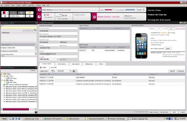
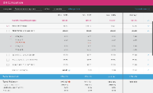



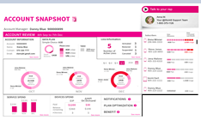
Multi Touch point, Multi channel
Example: Change Bill Cycle Widget on Web and stores
Seamless integration of Widgets to other Channels (web, dealers, call centers).
No retooling required for frontline users (eliminates massive retraining, parity and adoption challenges)
Widget view adapts to front end look and feel
Responsive Design for all types of devices (PC, Tablets and Smartphones)
Based on standard technologies and open source (React/Redux, HTML5, CSS3)
Stores
Web
Example: Bill Comparison Widget on Call centers systems
Call Center
Example: Account Review Widget on Web and Handset
Web

Slide 26
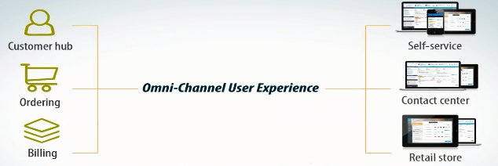




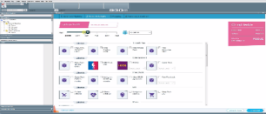
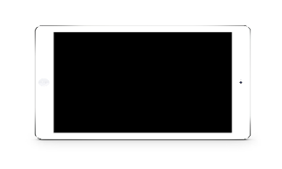
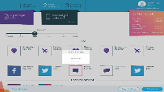


Digital Experience Layer - Create Once Deploy Many Across Channels & Touch Points
Web Components / Widgets (View)
Client SDK (Standard JS) – Headless Widgets
Web Self Service / CRM
REST API
Retail –Tablet App
Widget is a UI business building block aimed to deliver same capability in multiple channel
They can be with single view fully Responsive or different views tailored for channel
Mobile App
* Widget can have different view / UI

Slide 27

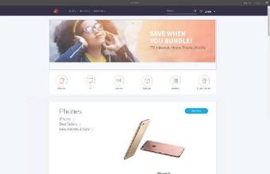
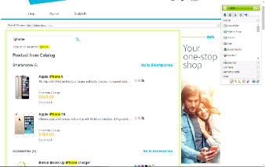
Experience Layer – Adobe Experience Manager
Widgets
Catalog
SEO
Personalization
Analytics
Tool to import widgets into AEM
Ability to manage configuration, content and navigation
Import Catalog to AEM
Enrichment of marketing attributes
Syncing the master catalog with changes
Exposing static content
SEO best practices such as sitemap, title and description tags etc.
AEM client context integration
Exposing BSS data in order to created personalized experience
Tracking users’ online behavior
Exposing events and data
Integration with Google Tag manager and Google analytics
Amdocs Mobile Enablement
WCMS
(AEM)
Commerce widgets
Billing care widgets
Support widgets
Customer care widgets
Multi modal plug-ins

Slide 28
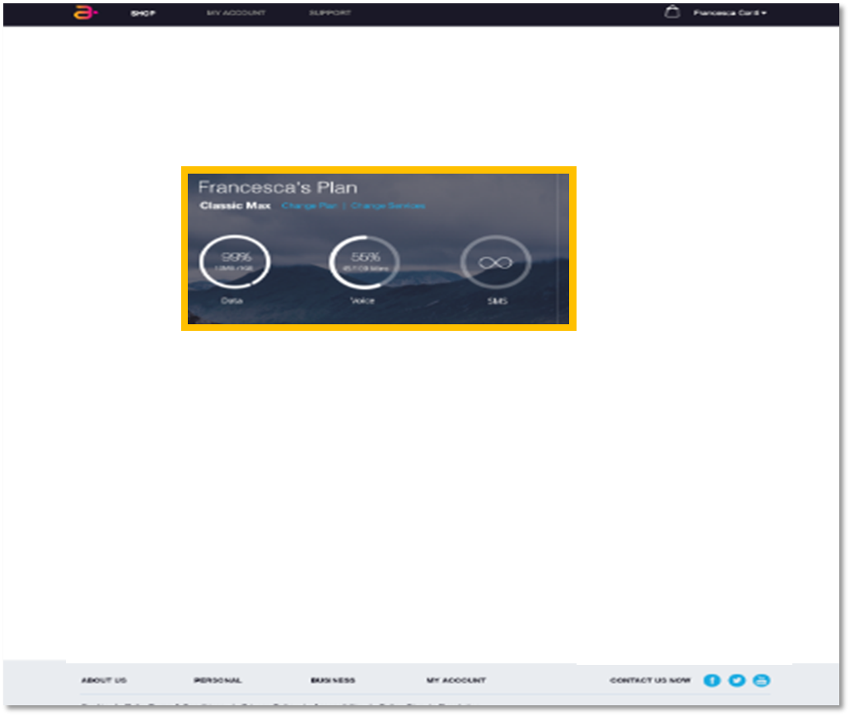
Hosting a widget
Widget Loading API
Embed a widget in dedicated place holder
Support flows by widget’s navigation configuration/handling
Embed a Flow
Same API as embedding a widget
Navigation will be internal to the widget
Embed a Frame (e.g. iframe)
Entire flow runs in fully isolated frame

Slide 29
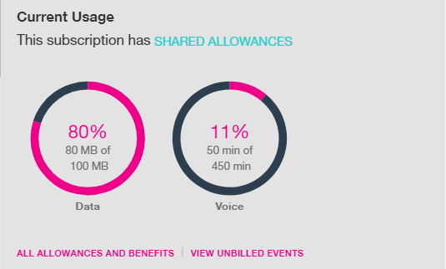
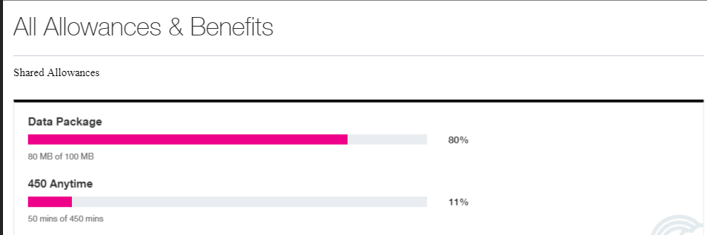
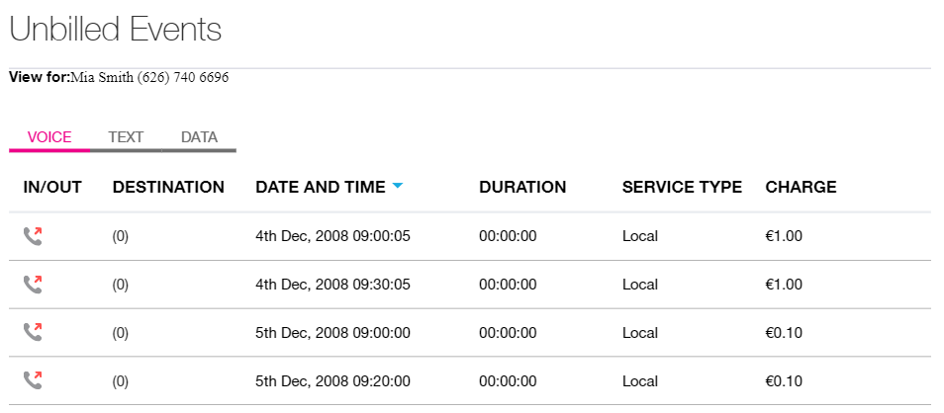
Standalone widget demo page
Each widget comes with a demo page
Ability to customize the widget based on config
Responsive design

Slide 30
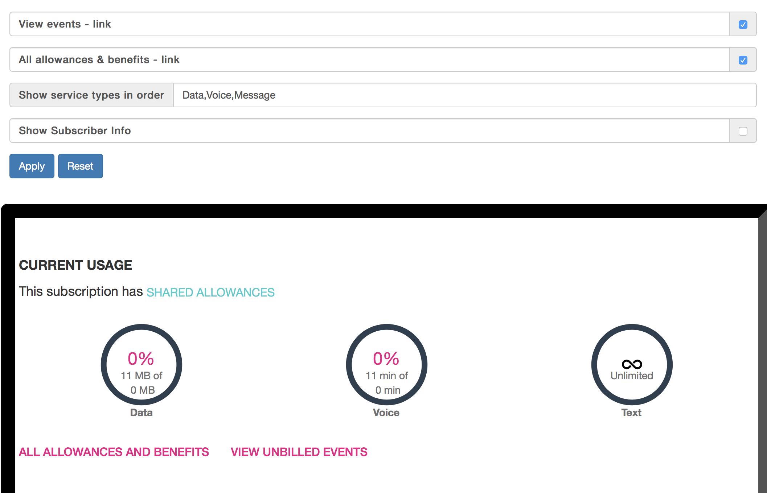
Widget Configuration
Behavior Configuration
Show/hide buttons links?
Order of data
Remove voice? text?
Content Configuration
Text in Title
Images
Navigation Configuration
Submit, Add to Cart
Cancel
Error

Slide 31
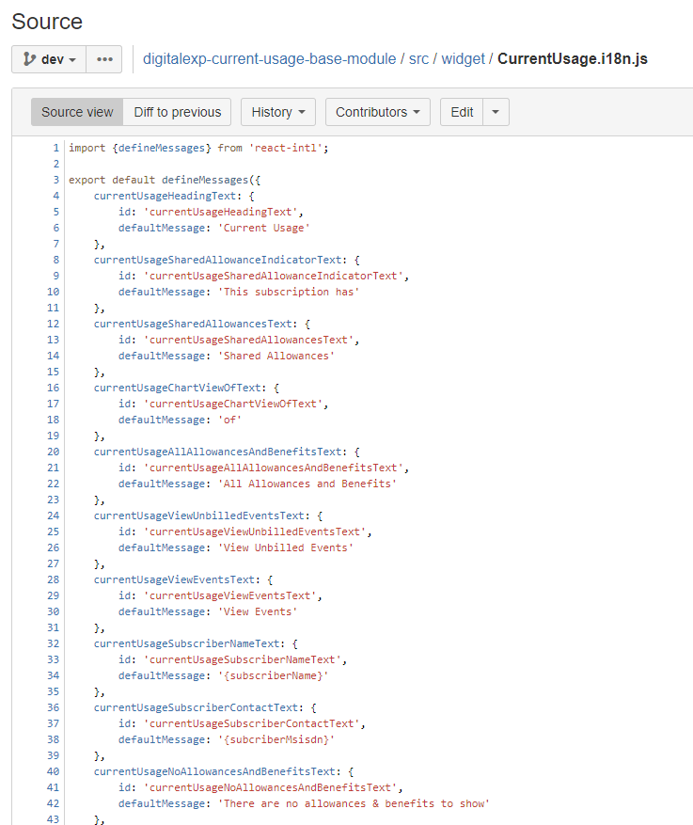
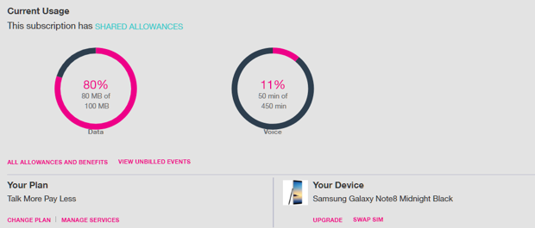
Widget Language
The labels are managed thorough i18n config file

Slide 32
Widget L&F and Style (CSS)
Amdocs is using SASS
It is possible to integrate Amdocs sass into hosting application sass and compile one css file
Or load directly Amdocs css to their page
Hosting application should provide style guideline
Hosting application can override styling
Hosting application can fully customize the view

Slide 33
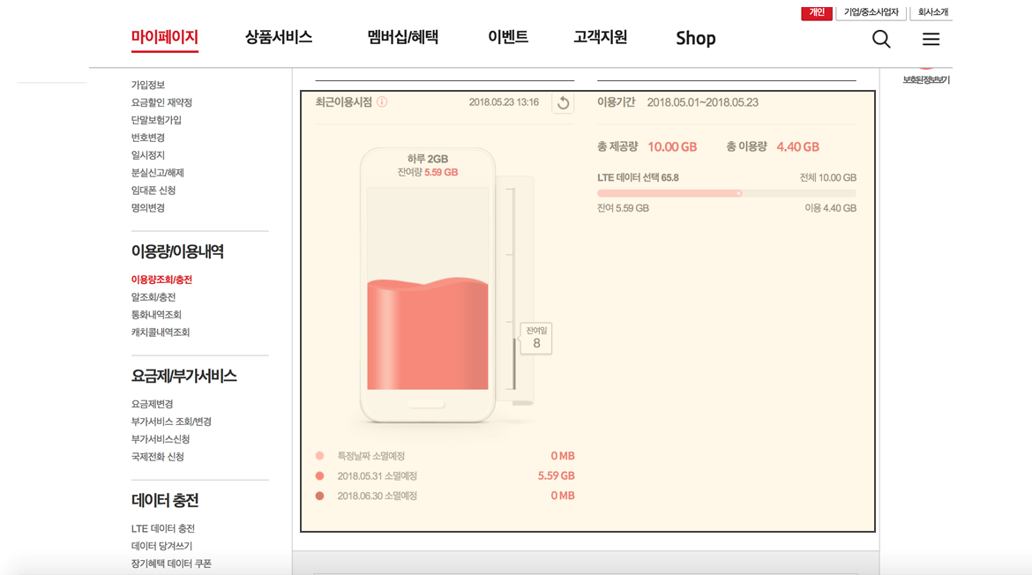
Widget Placement
Will the widget be embedded in existing page or in a new dedicate page?
If in existing page → need to prepare placeholder and share its size

Slide 34
Q & A

